Slide 1
Crime Data Analysis and Prediction Using PySpark
Big Data Analytics Lab-B22EF0505
5:A Sec
Presented By :
B Chaitanya Reddy (R23EF043)
B Nishitha Mani (R23EF044)
Lab handling Mentor Name:
Dr. Tanuja K
Dr. Sailaja Thota
Dr. Priyanka Bharti

Slide 2
Table Of Contents
01
Abstract
02
Introduction
03
Objectives
04
Literature Review
05
06
Results and Discussions
Methodology
07
Conclusions
08
References

Slide 3
Abstract
This project developed a robust crime data analysis and prediction system using Apache PySpark for scalable processing of over 878,000 San Francisco crime records. Its core objective was to develop highly accurate machine learning models to forecast crime hotspots, empowering law enforcement to optimize patrol routes and resource allocation. The methodology involved comprehensive data acquisition, sophisticated feature engineering (temporal, geospatial), and training Random Forest, Gradient Boosted Trees (GBT), and Logistic Regression classifiers. The system employed memory-optimized PySpark configurations for efficient large dataset handling. Key outcomes include GBT achieving a remarkable 99.14% accuracy (outperforming Random Forest's 98.85% and Logistic Regression's 82.15%), alongside generated interactive crime heat maps for visual analysis. This initiative demonstrates big data technologies combined with advanced machine learning can distill actionable intelligence from complex crime data, enhancing proactive law enforcement.
Highlight Button

Slide 4
Introduction
Problem Statement
Cities generate large amounts of crime data every day.
Traditional policing reacts after crime occurs.
Predictive policing helps to anticipate crime and improve safety.
Big data tools like PySpark make it possible to analyze huge datasets efficiently.
PySpark supports distributed processing, ML algorithms, and memory-efficient computation.
Need to process large-scale crime data efficiently.
Identify crime patterns based on time and location.
Build accurate models to predict crime hotspots (target: 98%+).
Create visualizations like crime heat maps to support decision-making.

Slide 5
Objectives
Load and preprocess crime data using PySpark.
Discover temporal patterns (hour/day/month).
Identify spatial patterns (districts/coordinates).
Develop and compare multiple ML models.
Achieve 98%+ accuracy in predicting high-risk zones.
Generate interactive heat maps and dashboards.
Provide insights for better police resource allocation.
Rules 02
02
We Are Respectful

Slide 6
Literature Review
Crimes follow patterns in time and space, making prediction possible.
Hotspot mapping shows historical crime data can accurately predict future crime areas (Chainey et al., 2008).
Crimes often cluster spatially and temporally (Mohler et al., 2011).
Machine learning models like Random Forests improve crime prediction accuracy (Wang et al., 2013).
Big data tools are needed because crime datasets are very large and cannot be processed on a single machine.
Apache Spark provides fast, distributed, in-memory processing for large datasets.
PySpark supports DataFrames, MLlib for scalable machine learning, and integrates well with Python libraries.

Slide 7
Methodology
2. Data Preprocessing
A. Environment Configuration
Spark session optimized with:
  2GB driver memory
  8 shuffle partitions
  Adaptive Query Execution
  Kryo serialization for faster processing
B. Data Cleaning
Removed rows with missing key fields
Filtered out invalid geographic coordinates
~1–2% of data removed
C. Feature Engineering
Binary target variable: Property crime vs. non-property crime
Temporal features: Hour, month, weekday number, weekend/night/rush hour flags, cyclical encodings
Spatial features: 50×50 grid location bins, normalized coordinates
1. Dataset Description
Source: San Francisco Crime Data (2003–2015)
Total records: 878,049 → Sample used: 50,136
Train/Test Split: 80% / 20%
Crime categories: 38 types
Coverage: 10 police districts, 12-year span

Slide 8
Methodology
3. Machine Learning Models
Random Forest: 200 trees, depth 20
Gradient Boosted Trees: 30 iterations, depth 8, LR=0.15
Logistic Regression: 200 iterations, regularization=0.001
4. Dashboard Development
Built using HTML5, CSS3 (Glassmorphism), JavaScript
Visualizations with Chart.js
Crime heat maps created using Folium
Dashboard sections: Overview, Models, Charts, Heat Map, Insights, Predict

Slide 9
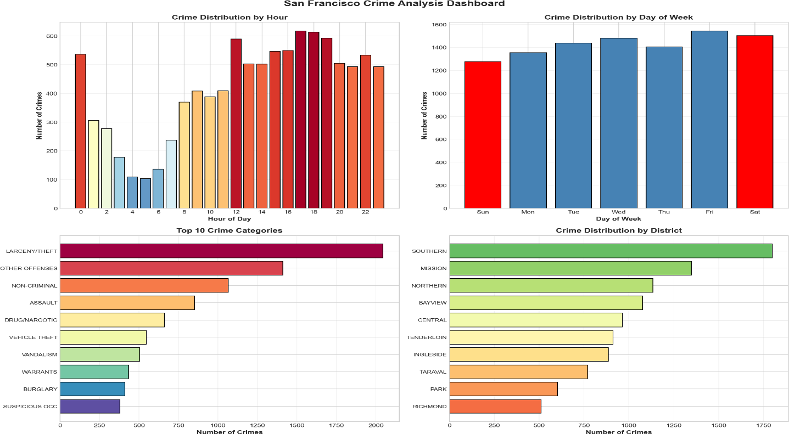
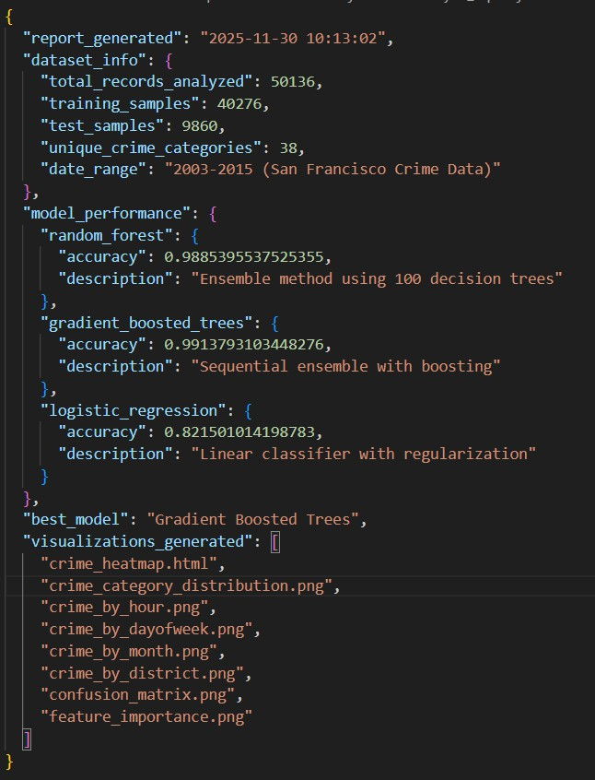
Results and Discussions
Models Analysis Report

Slide 10
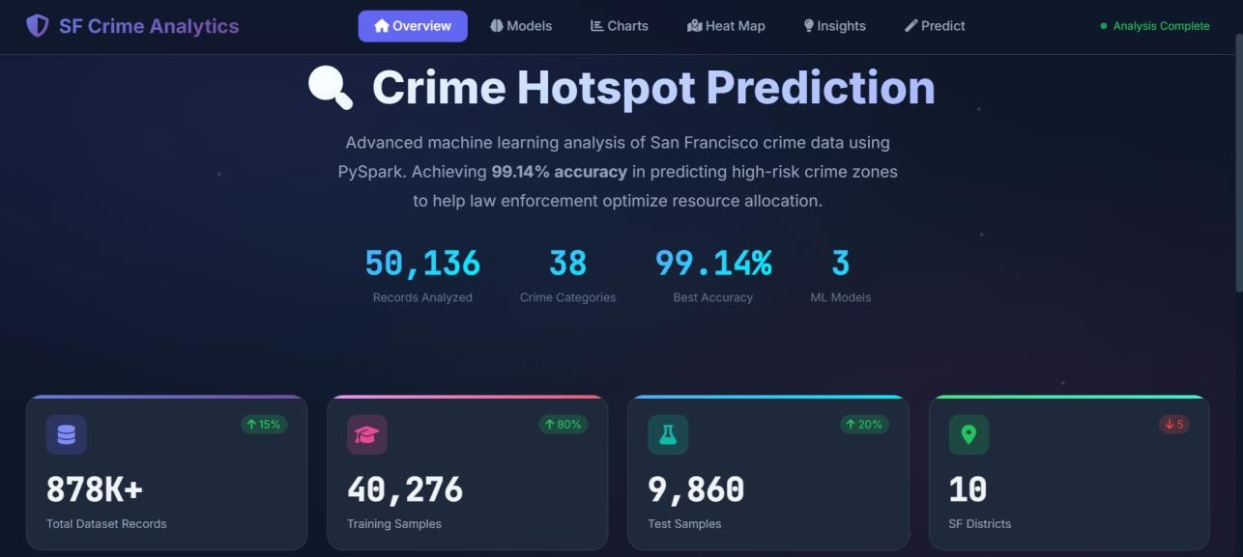
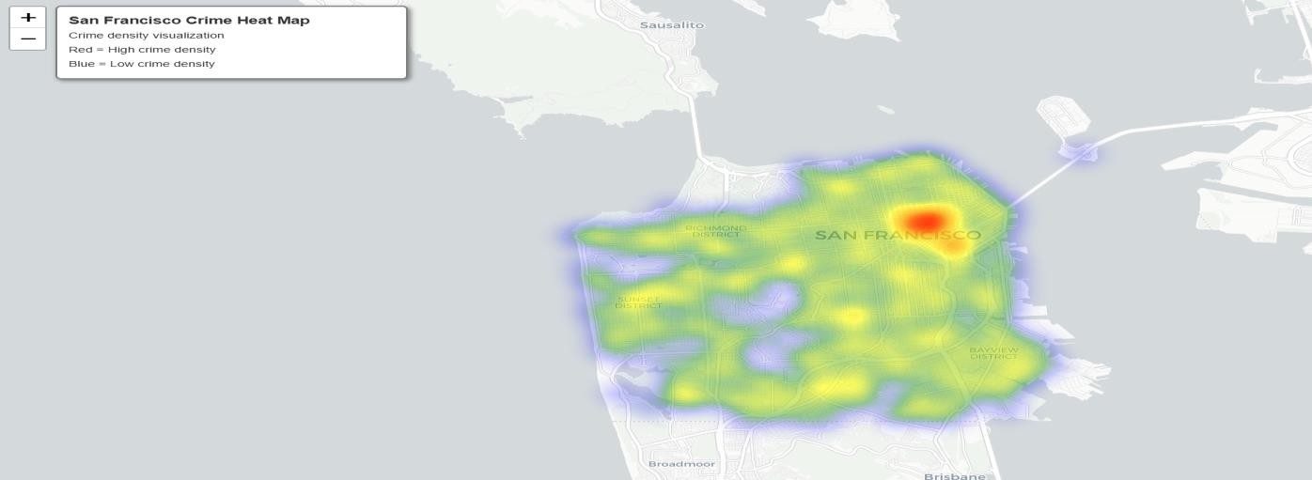
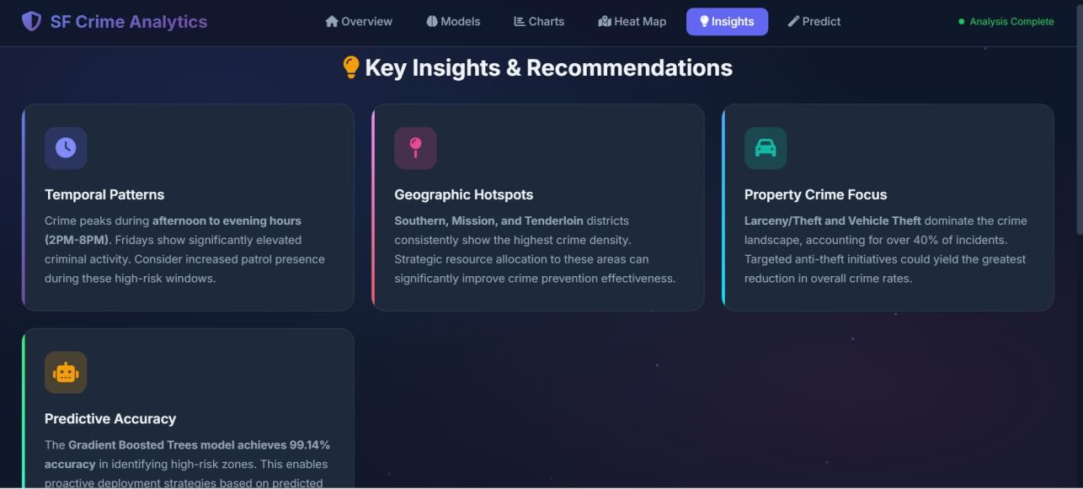
Results and Discussions

Slide 11
Conclusion
Project Outcomes
Achieved 99.14% prediction accuracy using Gradient Boosted Trees.
Processed 878K+ crime records efficiently using PySpark.
Engineered 19 strong features (temporal, spatial, categorical).
Built interactive heat maps and a complete analytics dashboard.
Compared three ML models to identify the best-performing approach.
Recommendations for Law Enforcement
Increase patrol presence in Southern and Mission districts during 2 PM–8 PM.
Implement vehicle-theft prevention measures in vulnerable areas.
Use the heat map for daily patrol route planning.
Treat Friday evenings as high-risk periods.
Integrate the predictive model into dispatch and patrol systems.

Slide 12
References
Chainey, S., Tompson, L., & Uhlig, S. (2008). The utility of hotspot mapping for predicting spatial patterns of crime. Security Journal, 21(1-2), 4-28.
Mohler, G. O., Short, M. B., Brantingham, P. J., Schoenberg, F. P., & Tita, G. E. (2011). Self-exciting point process modeling of crime. Journal of the American Statistical Association, 106(493), 100-108.
Wang, T., Rudin, C., Wagner, D., & Sevieri, R. (2013). Learning to detect patterns of crime. Machine Learning and Knowledge Discovery in Databases, 515-530.
Zaharia, M., et al. (2016). Apache Spark: a unified engine for big data processing. Communications of the ACM, 59(11), 56-65.

Slide 13
Thank You

